Slide 1

Warner Alexis.
Premiere League Winner prediction
12.06.2023

Slide 2

Online
INTRODUCTION
Abstract
Premier League background
Data analysis
Model development

Slide 3
abstract
Our goal toward the future
Winning the league is a major goal for every soccer team in the world. Modern coaches uses technology to analyze every facets of their games. Some coaches implement styles of football that give them more ball possessions, creating more chances and defend as unit to pressure the opponents to give back the ball and others create defensive walls to counter opponents when they lose the ball. All these new techniques are possible with the use of analytics platforms that captures players’ movements, performance at different positions, goals scored or against, shooting per players and clean sheets. The purpose of this project is to create a model that can predict the winner of Premiere League using goal scored , points and winning game counts from data collected for the past 5 seasons. Two models will be evaluated in the creation of the prediction. One multiple regression using categorical values to classify Team based on their overall performance and a linear regression to predict wins using goal scored and point. Linear regression model predict the highest point a team can have for a following season. Therefore, the team with the highest point would be able to win the league and qualify for Champion League.

Slide 4

Premier League background
Let’s Dive In

Slide 5
Premier League is the highest level of football competition that ever created by the English football league system. The league promotes 3 teams from the second division and relegate 3 teams with lowest points every season. First four teams with the highest points qualify for the UEFA Champions
Premier league Background

Slide 6
library(rvest) library(tidyverse) library(vtable) library(tidyverse) library(hrbrthemes) library(viridis) library(StatsBombR) library(devtools) library(ggsoccer) library(tidyverse) library(ggpubr)
Library

Slide 7

STATSBOM season Data

Slide 8
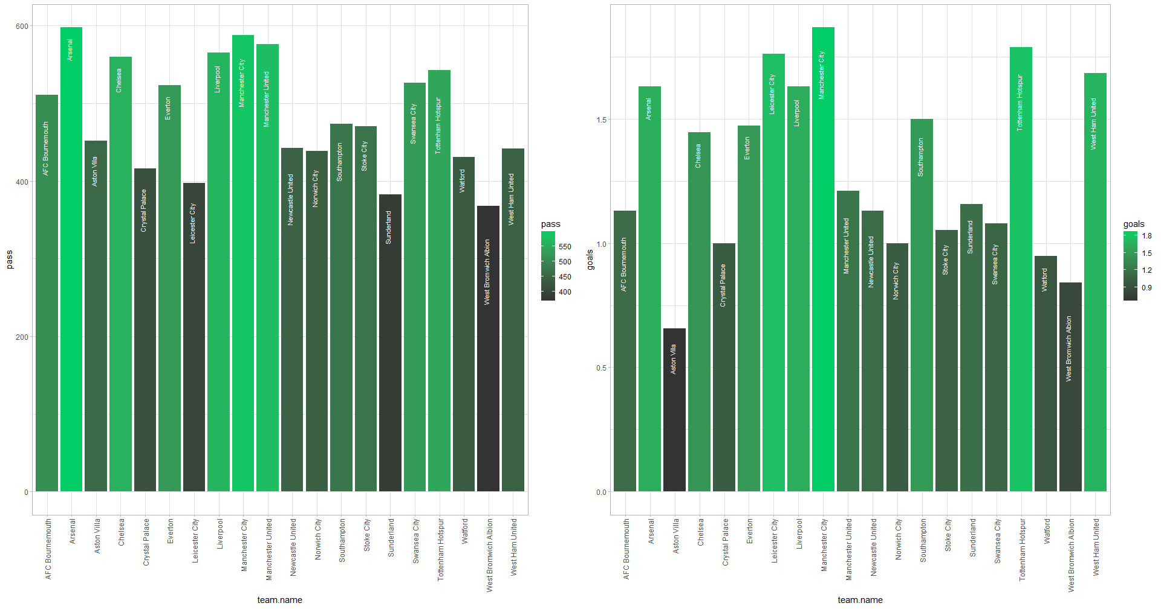
Notes:
The team with the high passing ratio is more likely to score a goals because they keep possession and do not loose the ball often

Slide 9
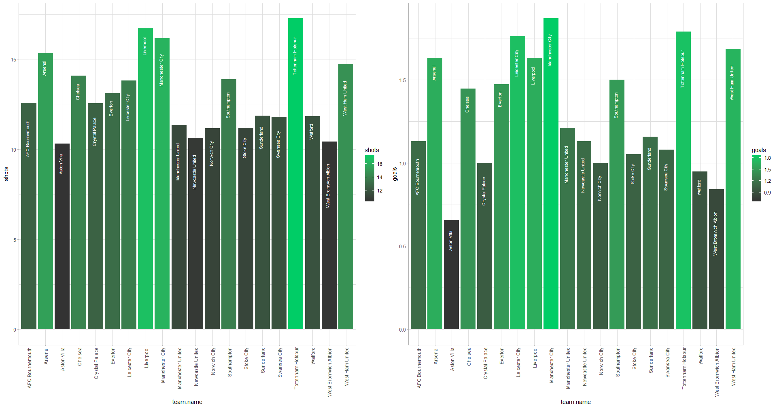
Notes:
The team with the high shooting ratio is more likely to score a goals because they keep have more chances to hit the target.

Slide 10
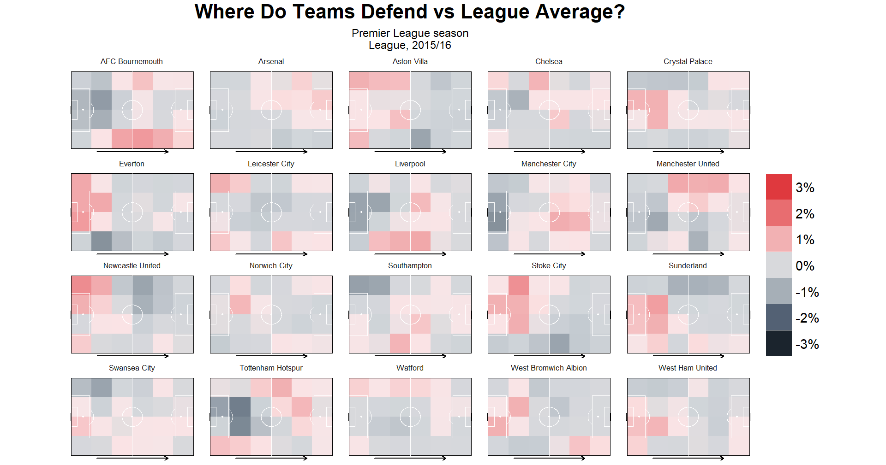
Team Performance scale
Notes:
For the past five seasons, Teams with highest goals score have dominated the league and most likely to won the won the league because of the amount of goal scored

Slide 11
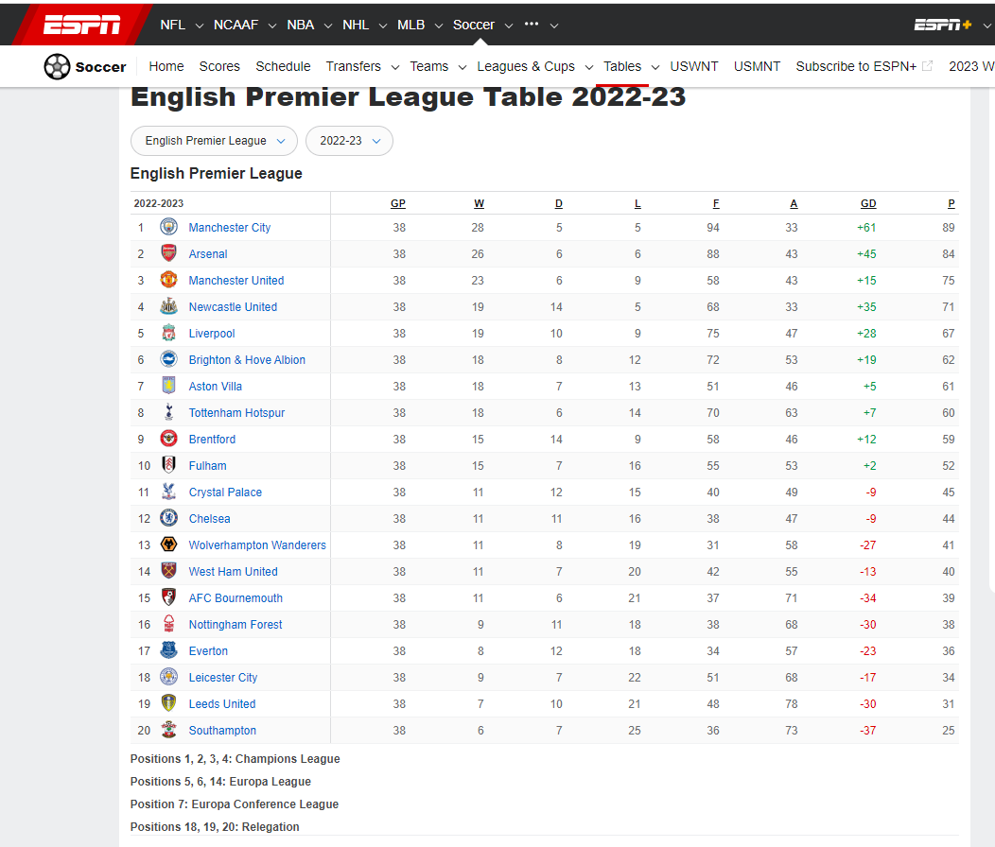
Premier league Data
Notes:
The team with the high shooting ratio is more likely to score a goals because they keep have more chances to hit the target.

Slide 12
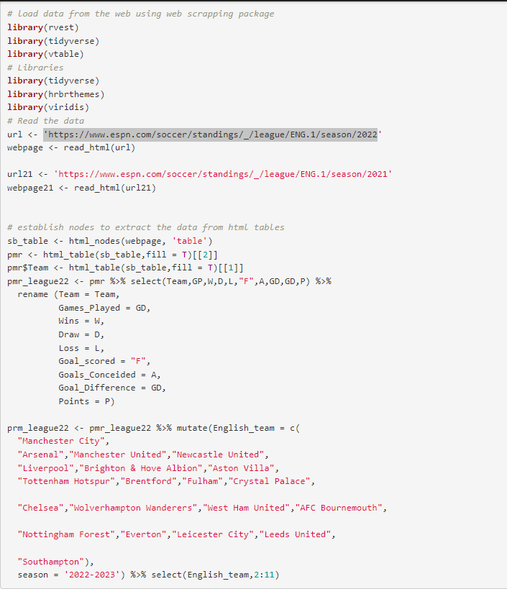
Premier league Data
Notes:
The team with the high shooting ratio is more likely to score a goals because they keep have more chances to hit the target.

Slide 13
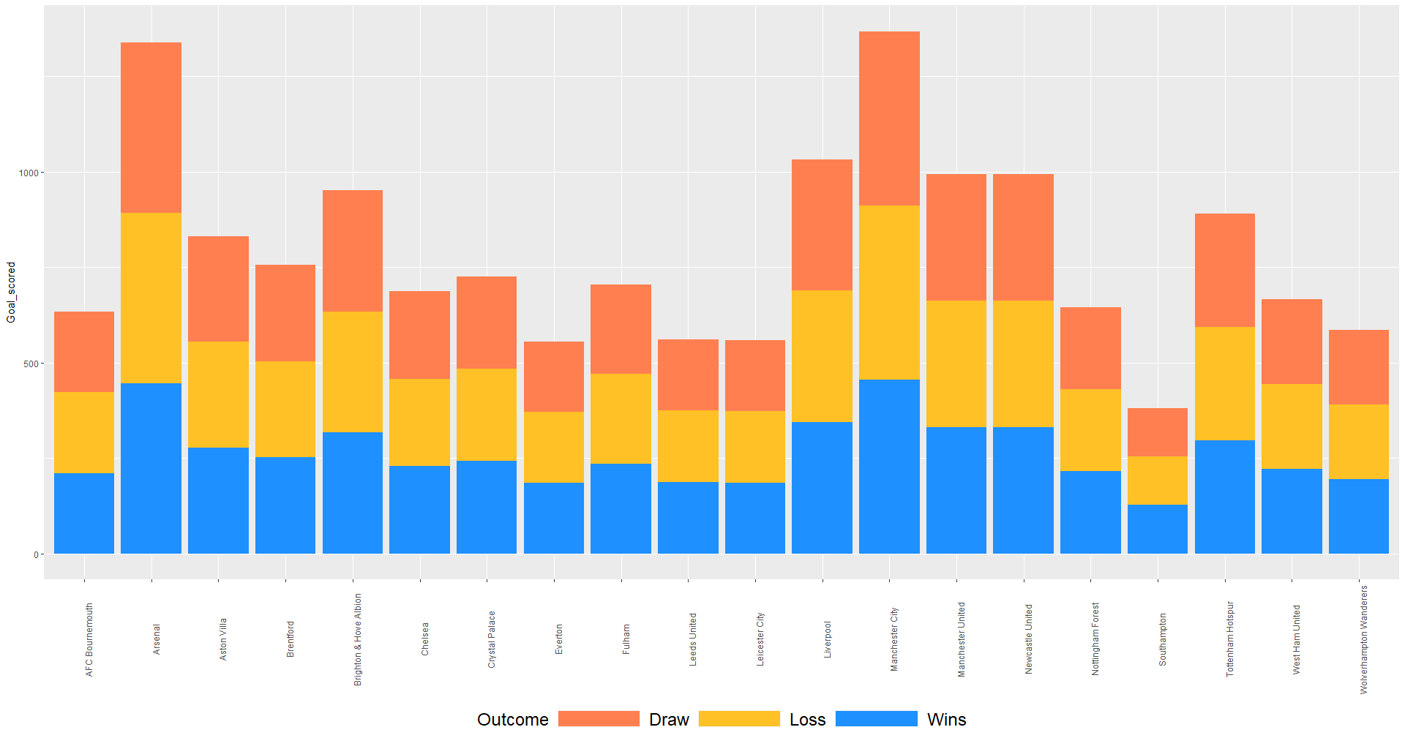
Goal scored for the past five seasons
Notes:
For the past five seasons, Teams with highest goals score have dominated the league and most likely to won the won the league because of the amount of goal scored

Slide 14
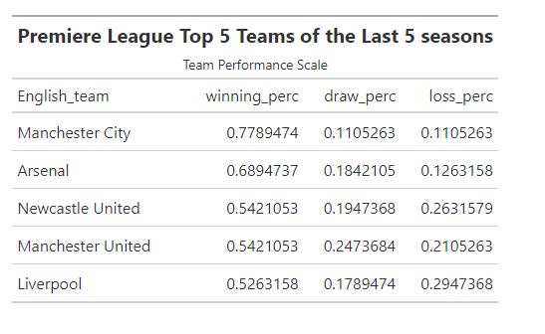
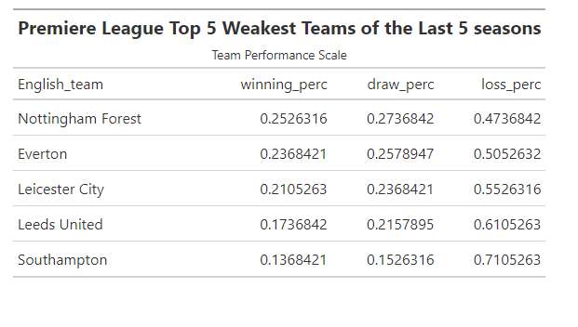
Team Performance scale
Notes:
For the past five seasons, Teams with highest goals score have dominated the league and most likely to won the won the league because of the amount of goal scored

Slide 15
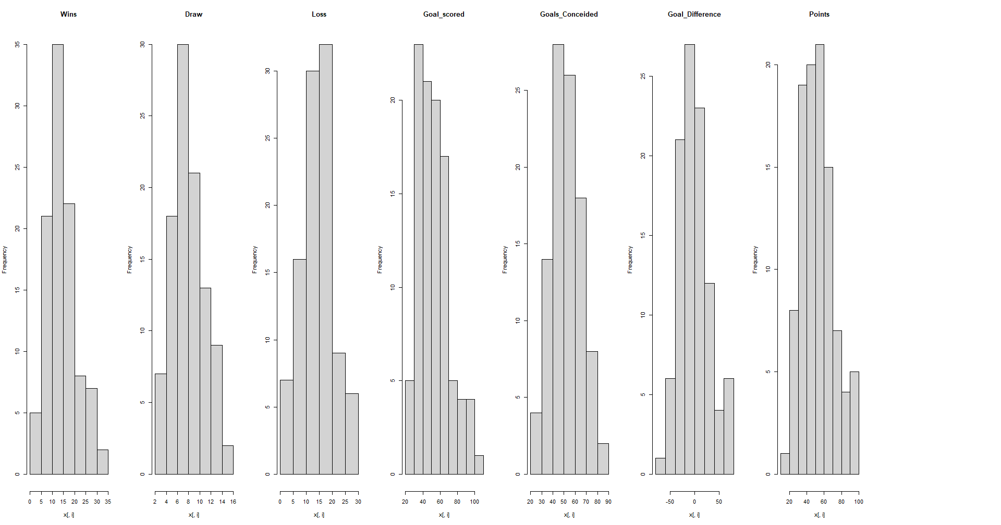
How the attributes are related?
Notes:
For the past five seasons, Teams with highest goals score have dominated the league and most likely to won the won the league because of the amount of goal scored

Slide 16
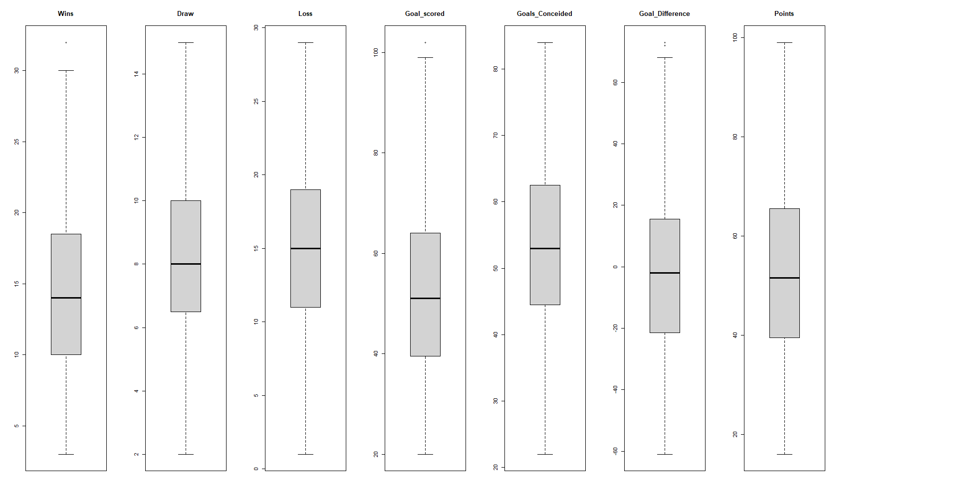
How the attributes are related?
Notes:
For the past five seasons, Teams with highest goals score have dominated the league and most likely to won the won the league because of the amount of goal scored

Slide 17
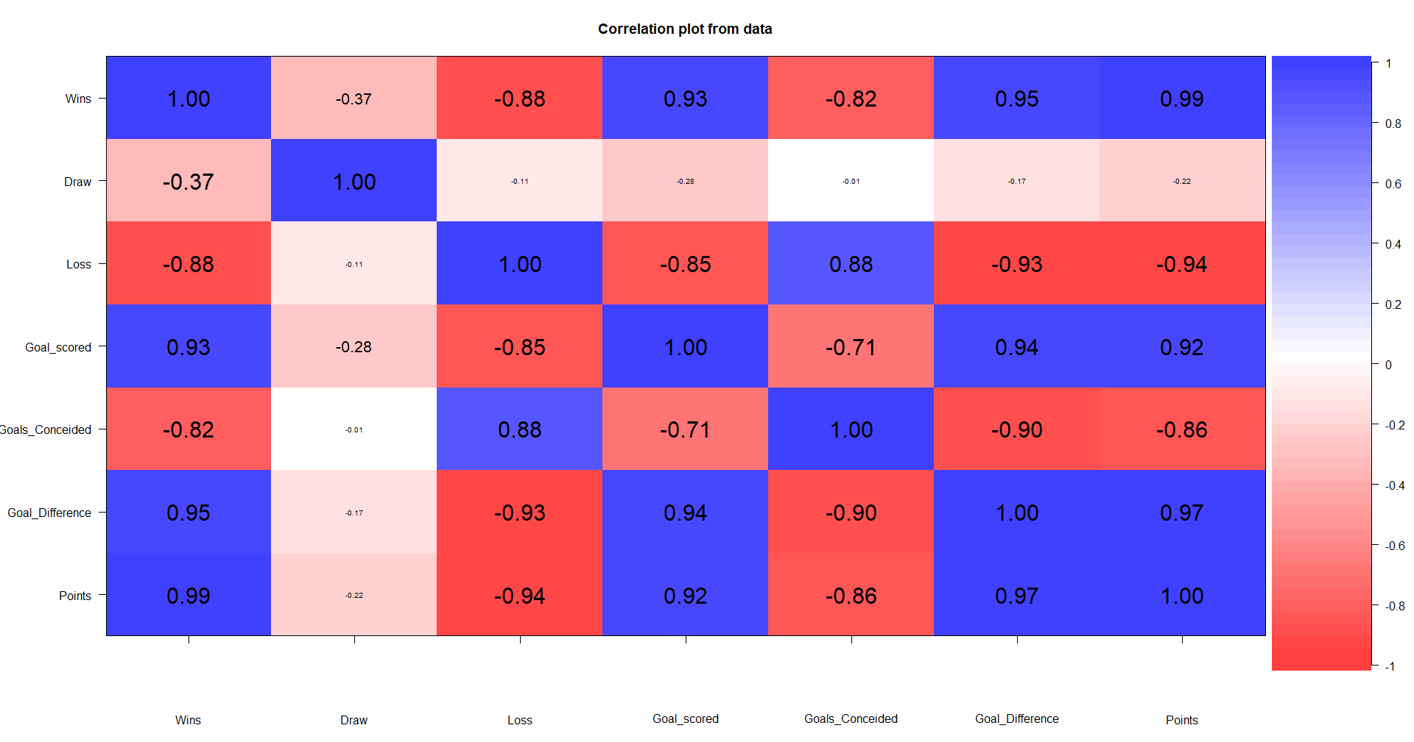
Relationship between Variables
Notes:
For the past five seasons, Teams with highest goals score have dominated the league and most likely to won the won the league because of the amount of goal scored

Slide 18
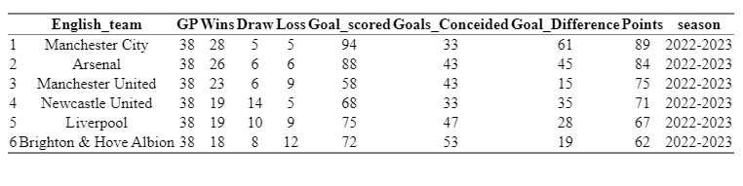
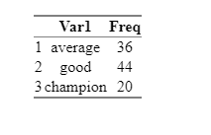
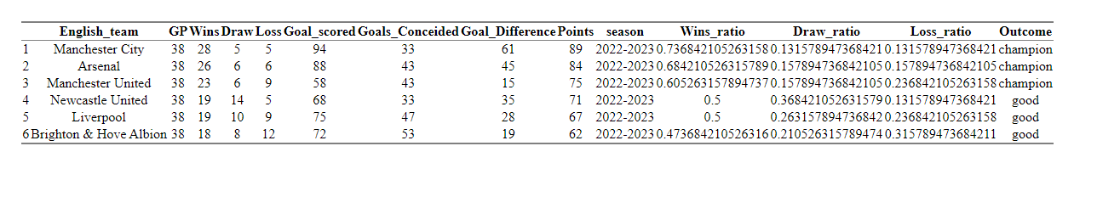
categorical Value
4new more rows:
Win ratio
Loss Ratio
Draw ratio
Outcome:
Champion
Win ratio > 0.52
Good >= 0.30 and 0.51
Average >= 0 and 0.29

Slide 19
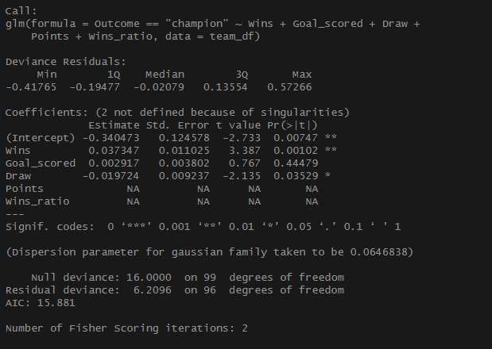
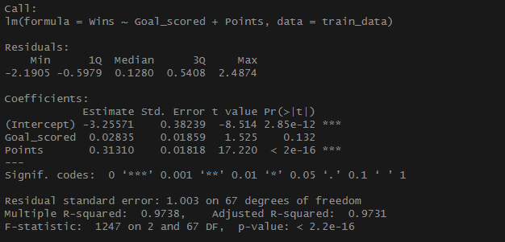
Model Development

Slide 20
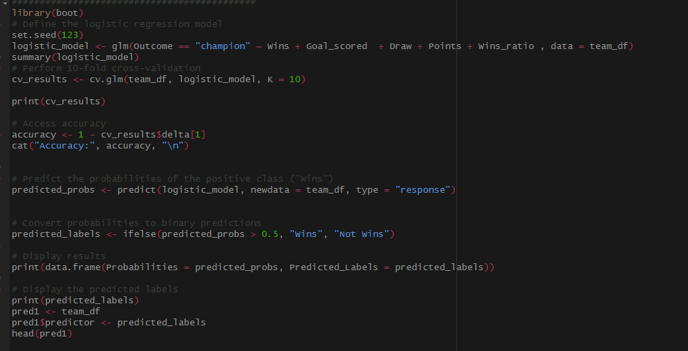
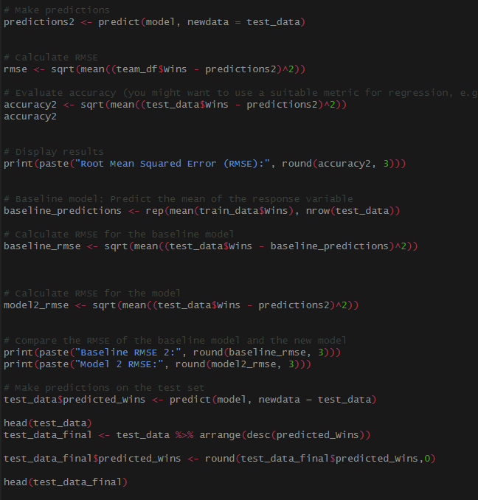
Model Development

Slide 21
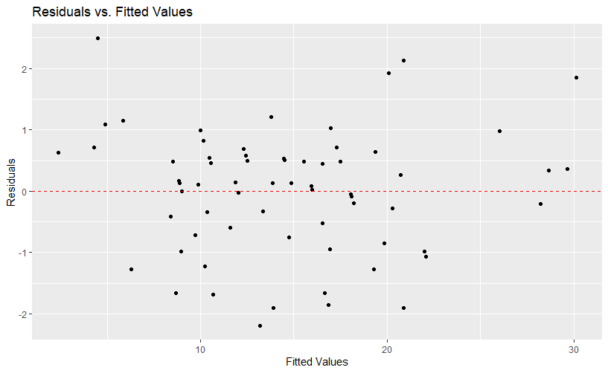
Model 2

Slide 22
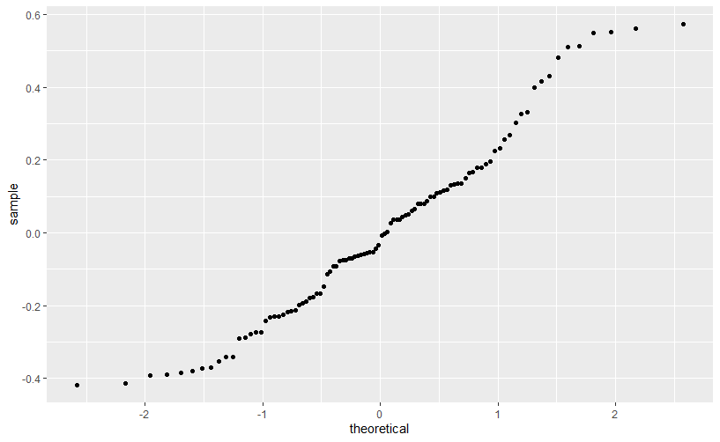
Model 1 Residual

Slide 23
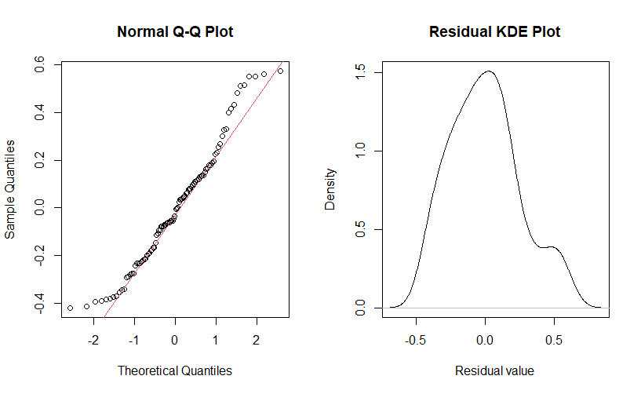
Model 1 Residual

Slide 24
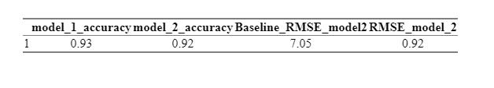
Accuracy Table
Model 1
Model 2
Model 1 has better accuracy
Use categorical Value to useful for classification problems
The model were able to predict Team that mostly able to Win the Premiere leagues
Model 2 has approximately the same accuracy
Use Goal scored and Points to predict the amount of wins a team can have
It comes to our conclusion that Teams with high goals scoring ability accumulates more points per season and are more likely to win the Premiere leagues and qualify for Champion league which requires the top 4 teams.
Notes:
Prediction probabilities are particularly useful in the context of classification problems, where the goal is to assign observations to different classes or categories. In such cases, prediction probabilities provide additional information beyond the class predictions themselves

Slide 25
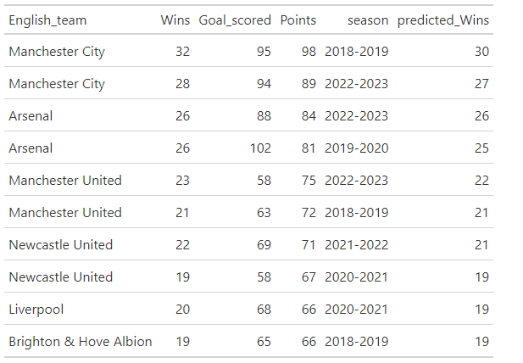
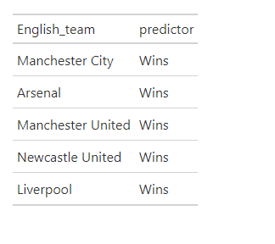
Prediction Table
Model 1 predicts Teams that are most likely to win Premier League and qualify for Champion League
Model 1 predict teams that can generate more points in the league for every following season on the test set.

Slide 26
References
Predicting box ofﬁce success: Do critical reviews really matter? (n.d.). https://rmmody.github.io/pdf/585Project.pdf
Works CitedAccessing & Working with StatsBomb Data in R. https://statsbomb.com/wp-content/uploads/2021/11/Working-with-R.pdf
ESPN Internet Ventures. (n.d.). 2018-19 English premier league standings. ESPN. https://www.espn.com/soccer/standings/_/league/ENG.1/season/2018
ESPN Internet Ventures. (n.d.). 2018-19 English premier league standings. ESPN. https://www.espn.com/soccer/standings/_/league/ENG.1/season/2019
ESPN Internet Ventures. (n.d.). 2018-19 English premier league standings. ESPN. https://www.espn.com/soccer/standings/_/league/ENG.1/season/2020
ESPN Internet Ventures. (n.d.). 2018-19 English premier league standings. ESPN. https://www.espn.com/soccer/standings/_/league/ENG.1/season/2021
ESPN Internet Ventures. (n.d.). 2018-19 English premier league standings. ESPN. https://www.espn.com/soccer/standings/_/league/ENG.1/season/2022
AlMulla J, Islam MT, Al-Absi HRH, Alam T. SoccerNet: A Gated Recurrent Unit-based model to predict soccer match winners. PLoS One. 2023 Aug 1;18(8):e0288933. doi: 10.1371/journal.pone.0288933. PMID: 37527260; PMCID: PMC10393150.

Slide 27

Conclusion
Teams with the ability to score goals and concede less goals and generate more points are more likely to Stay in the tournament and won the league. Both models are to useful to answer our questions. Model 2 significantly predict the number of wins based of the goal scored and Point accumulated after each wins.

Slide 28



THANK YOU
Warner Alexis
00000000000
WARNER.ALEXIS44@spsmail.cuny.edu
Premier League Winner Predictions

